Slide 1
FIFA Rating vs Real Life Performance
By: Alexander Christopher

Slide 2
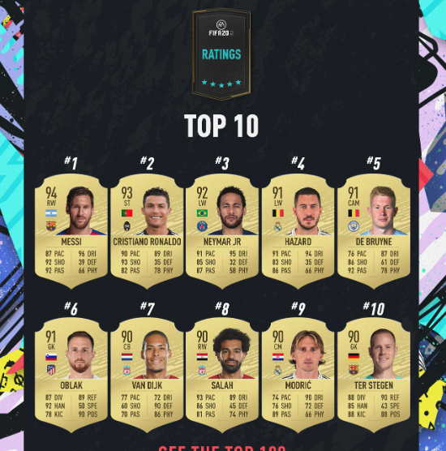
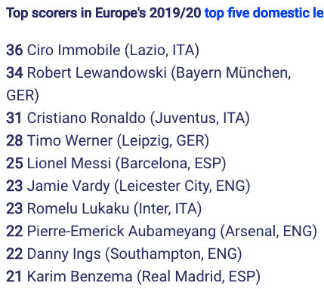
The Objective
Exploring the dataset to see if there are any trends/correlation among the players FIFA rating and their real life results

Slide 3
Are FIFA Ratings Realistics to the how the players actually play?
“EA Sports employs a team of 25 EA Producers and 400 outside data contributors. This team is responsible for ensuring all player data is up to data, while a community of over 6,000 FIFA Data Reviewers or Talent Scouts from all over the world…”
Ronan Murphy from www.Goal.com

Slide 4
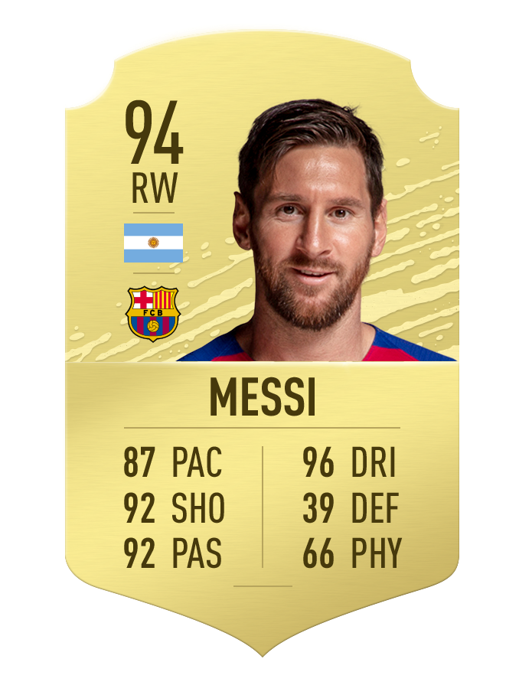
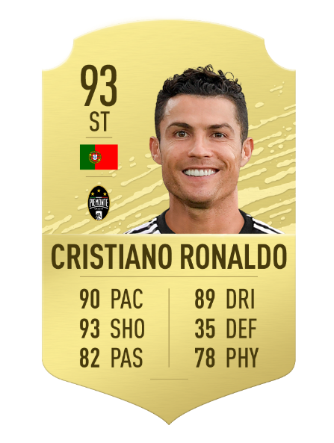
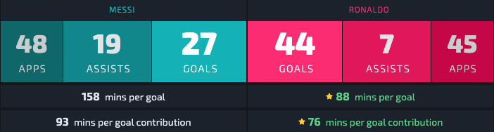
Potential Problems
The short answer is yes, but the longer answer is maybe
Finding data that is up to date, accurate, and inclusive

Slide 5
Process
Finding data
Importing data
Cleaning and modifying data (In Process)
Removing null values from both datasets
Removing players that are not in both datasets
Filtering out players based on their attributes (goalies)
Using data science mechanism to find correlation (Future Work)
Visualizing the data (Future Work)
Create an interactive visualization
Potential visualizations

Slide 6
Potential Visualization

Slide 7
